Slide 1
Lecture 10: Array and String

Slide 2
Objectives
Understand the concept of array and its memory organization
Know how arrays are declared and initialized
Know how arrays are accessed
Use multi dimensional arrays
Know about string representations
Know about various character and string functions

Slide 3
ARRAYS
Declaration, initialization, storing values, retrieving values

Slide 4
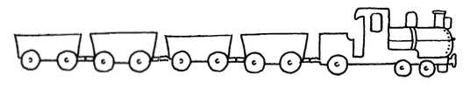
Need for an array
Many applications require the processing of multiple data items with
Common characteristics (e.g., same data type)
E.g., set of numbers, set of characters, set of names
‘O’
‘N’
‘E’
‘\0’
0
1
2
3

Slide 5
Array
It is used to store
similar data items
in contiguous memory locations
under a single name
It holds a fixed number of equally sized data elements (of the same data type)
The individual elements are accessed by
specifying the subscript/index using [] operator
Index start from 0, increased by 1 for every element

Slide 6
Memory Organization of an Array
Address of an element is calculated as
Name of an array refers to the base address of the array
Address of i^{th} location = base address + (size of an element * index i)
E.g., an array of 3 integers
Size of each element is 4
Starting memory location is 1000
Address of 0th element = 1000 + 4*0 = 1000
Address of 1th element = 1000 + 4*1 = 1004
Address of 2nd element = 1000 + 4*2 = 1008
Total of 12 bytes are allocated in the memory of this array
Value | 2 | 4 | 5
Index | 0 | 1 | 2
Memory loc. | 1000 | 1004 | 1008

Slide 7
Array Declaration
Arrays are declared with appropriate data type and size
Arrays can be of single dimension or multi dimensions
Array declaration reserves space in memory
General form:
datatype arrayname[size];

Slide 8
Examples
Defines an integer array x of 5 integers starting at x[0], and ending at x[4]
int x[5];
Defines a character array, which represent a string of maximum 16 characters
char str[16]=“qwerty”;
Defines a floating point array sa of 10 floating points starting at sa[0], and ending at sa[9]
float sa[10];

Slide 9
Accessing Array Elements
The array elements are accessed by specifying the subscript/index inside [] operator
General form
arrayname[index of the element]
Examples
x[0] -> access the 1st element in x
x[3] -> access the 4th element in x
str[2] -> access the 3rd character in string (str)

Slide 10
Array Initialization
Array elements can be initialized during declaration or in the program
When arrays are initialized during declaration, partial initialization is allowed
In partial initialization, the uninitialized elements are initialized to
Zero for numeric array
Null for character array
If initialized, array can be declared without specifying exact size
The size equals to the number of elements initialized
General forms
datatype arrayname[size] = {values(s)}
datatype arrayname[] = {values(s)}

Slide 11
Array declaration/initialization
int a[5] = {1, 2, 3, 4, 5};
/*a[0]=1; a[1]=2; a[2]=3; a[3]=4; a[4]=5; */
int a[5] = {0};
/*all the array elements are initialized to zero
int a[5] = {1, 2, 3, 4};
/*a[4] = 0*/
int a[] = {1, 2, 3, 4};
/*a[0]=1; a[1]=2; a[2]=3; a[3]=4; (if not specified, the size depends on the number of values initialized)*/
float b[2} = {10.2, 45.34};
/*b[0]=10.2; b[1]=45.34;*/

Slide 12
Basic Operation on Arrays
Basic operations allowed on arrays are
Storing array elements
Retrieving array elements
Processing array elements
Insertion and Deletion can be done by moving array elements to the appropriate places
Note that C doesn’t allow to assign an array to another array
E.g., arrayA = arrayB; is invalid

Slide 13
Getting the value for Arrays
int a[3];
(1)
scanf(“%d”, &a[0]); /*gets value for the 1st location*/
scanf(“%d”, &a[1]); /*gets value for the 2nd location*/
scanf(“%d”, &a[2]); /*gets value for the 3rd location*/
(2)
scanf(“%d%d%d”, a, a+1, a+2);
/*get values for first 3 locations*/
(3)
for(i=0;i<3;i++){
scanf(“%d”, &a[i]);
}
/*loop statement is used to set/get the array elements*/

Slide 14
Printing out the array elements
int a[3];
(1)
printf(“%d”, a[0]); /*prints value of 1st location*/
printf(“%d”, a[1]); /*prints value of 2nd location*/
printf(“%d”, a[2]); /*prints value of 3rd location*/
(2)
print(“%d%d%d”, a[0], a[1], a[2]);
/*prints values of first 3 locations*/
(3)
for(i=0;i<3;i++){
printf(“%d”, a[i]);
}
/*loop statements is used to print the array elements*/

Slide 15
Activity: working with array
Make a program to
Ask user to input 5 integers and put them into one array
Display all the input elements to the screen
Add more code to the previous program to
Find maximum value of the added integers

Slide 16
Multi-dimensional Array
The elements of an array can themselves be arrays
Multidimensional arrays will also occupy the contiguous memory locations
Two dimensional arrays can be viewed as set of one dimensional array (rows & columns)
Three dimensional arrays can be viewed as set of two dimensional arrays

Slide 17
Two-dimensional array - declaration
Two-dimensional arrays are defined in the same way as one dimensional array
Except that a separate pair of square of brackets is required for second dimension
General form
datatype arrayname[row][column]

Slide 18
Two dimensional array example
int a[2][2]; //creates 16 bytes of contiguous memory loc.
/*elements are stored in row major order. Elements of 1st row are stored first then the elements of next row*/
/*Assume that array starts at location 1000:
a[0][0] will be in location 1000 – row 0 & column 0
a[0][1] will be in location 1004 – row 0 & column 1
a[1][0] will be in location 1008 – row 1 & column 0
a[1][1] will be in location 10012 – row 1 & column 1
*/

Slide 19
Two-dimensional array initialization
int num[2][3] = {1, 2, 3, 4, 5, 6};
/* a[0][0] = 1; a[0][1]=2; a[0][2]=3;
a[1][0] = 1; a[1][1]=2; a[1][2]=3;*/
/*1, 2, 3 are in the 1st row, and 4, 5, 6 are in the 2nd */
int num[2][3] = {1, 2, 3, 4, 5}; /*num[1][2]=0*/
int num[2][3] = {{1, 2, 3}, {1, 2, 3}};
/*row elements are initialized separately*/
int num[2][3] = {{1, 2}, {4}};
/*num[0][2] = 0; num[1][1]=0; num[1][2]=0;*/

Slide 20
Advantages/Limitations of arrays
Advantages
Simple and easy to use
Stored in contiguous locations
Fast retrieval because of its indexed nature
No need to worry about the allocation and de-allocation of arrays
Limitations
Arrays are static in nature (fixed size). Memory is allocated at the beginning of the execution. If n is defined and used m -> wasted n-m
No automatic array bounds checking during compilation

Slide 21
STRING
String declaration, input/output strings, string functions

Slide 22
Strings
String is a sequence of characters
In C, there is no built-in data type for strings
String can be represented as an array of characters
String should always have a NULL character (‘\0’) at the end, to present the end of string.
String constants can be assigned to character array variables
String constants are always enclosed within double quotes (“”)

Slide 23
Strings
//(1)
char c[4] = {‘s’, ‘u’, ‘m’, ‘\0’};//defining string “sum”
//(2)
char str[16]=“qwerty”;
/*creates a string. The value at str[5] is the character ‘y’. The value at str[6] is ‘\0’. The values from str[7] to str[15] are undefined and wasted.*/
//(3)
char name[5] = “Vietnam”;
/*Strings are terminated by the null character, it is preferred to allocate 1 extra space to store null terminator*/

Slide 24
Array of Strings
Two dimensional character arrays are used to represent array of strings
General Declaration Form
char arrayname[no. of strings][max no. of chars in one string];
E.g., char sName[50][15]; //50 names, each maximum 14 characters;

Slide 25
Array of String initialization
General form
char arrayname[r][c] = {“value1”, “value2”, …};
Examples
char names[3][5] = {“Mr. A”, “Ms. B”, “Mr. C”};

Slide 26
Input strings
You can use gets or scanf functions to read inputs for strings
Example, a variable name is declared as
char name[10];
Then you could get name from input as
scanf("%s", name); //get name terminated by space
scanf("%[^\n]s", name);//get name including spaces
gets(name);//get name including spaces

Slide 27
Illegal operations on Strings
C does not allow one array to be assigned to another, thus statements of following forms are illegal
Assignment is not allowed
name=“Good” or name1 = name;
Concatenation is not allowed
name = name + “ to C“;
Comparing two strings is not allowed
if(name1==name){…}

Slide 28
Activity
Make a program to
Ask user to input 5 names
Store them in an array
Then print them out to the screen

Slide 29
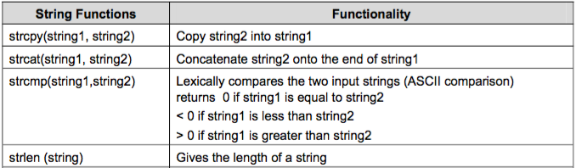
String functions
String doesn’t provide any operator to manipulate entire string at once
Strings are manipulated via functions available from standard string library string.h
There are many functions, but the followings are the frequently used ones

Slide 30
Activity
Create a program to
Ask user to input two strings and compare them
Create another program to
Ask user to input a student id
Make sure the length of the student id is 7

Slide 31
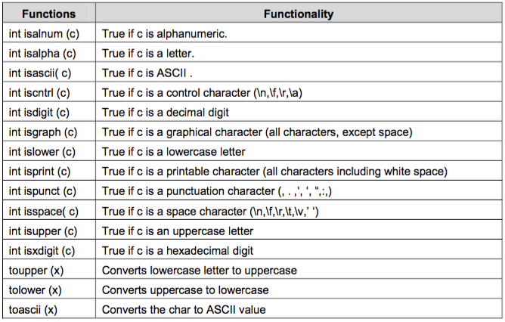
Character functions

Slide 32
Activity
Create a program to
Ask user to input student id of the form GTxxxxx or GCxxxxx (x: is a digit)
Validate the ID, and if it is valid then display it

Slide 33
Summaries
Understand the concept of array and its memory organization
Know how arrays are declared and initialized
Know how arrays are accessed
Use multi dimensional arrays
Know about string representations
Know about various character and string functions

